Slide 1
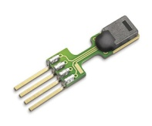
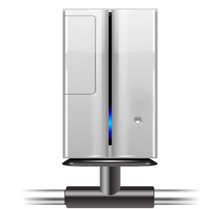
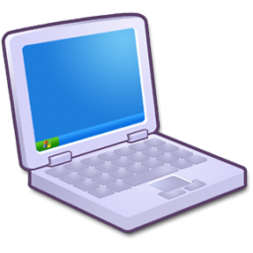
Your Sensor
Your registration and data storage server
http://motes.eecs.berkeley.edu
Analog to Digital Converter
Internet
Your Application
This is all you have to do
CoAP
Your CoAP requests
IPv6
magic
Mote running
OpenWSN

