Slide 1
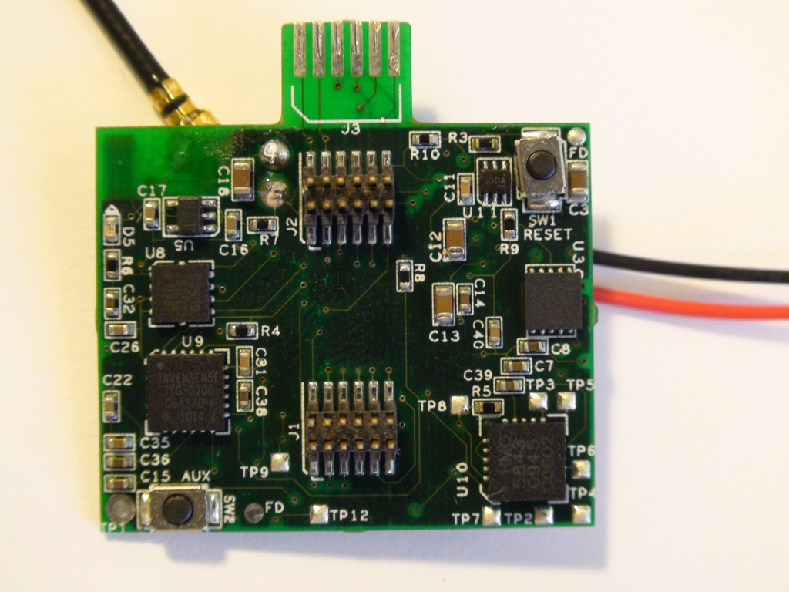
X
Y
Z
sensitive accelerometer (STMicroelectronics)

Slide 2
X
Y
Z
magnetometer

Slide 3
X
Z
Y
large-range accelerometer (Kionix)

Slide 4
Y
X
Z
gyroscope

