Slide 1
Security Implementation Proposal for OpenWSN
Marcelo Barros de Almeida
marcelobarrosalmeida@gmail.com

Slide 2
IEEE 802.15.4e 2012 SECURITY
Proposal:
Security level 5:
Frame authentication (four bytes MIC)
Data encryption
AES-CCM*:
AES-128
key length: 128 bits
Authentication: AES-CBC-MAC
Encryption/decryption: AES-CTR

Slide 3
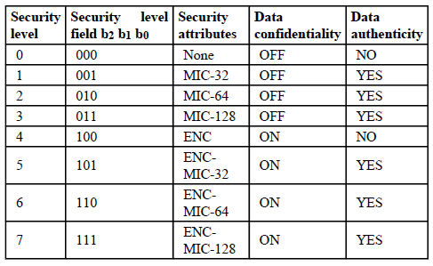
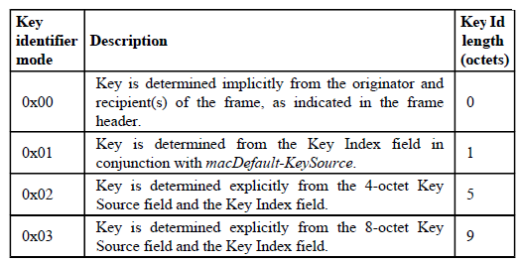
IEEE 802.15.4e 2012 FRAME
2B 1B 0-10B 0-10B 0-14B 0-16B 2B
FRAME
CTRL
SEQ
NUM
DESTINATION
ADDRESS
SOURCE
ADDRESS
AUX. SEC.
HEADER
IE
HDR
IE
PYL
PAYLOAD
MIC
CRC
MAC HDR
MAC PAYLOAD
MAC FOOTER
1B 4B 0-9B
SECURITY ENABLE = 1
SECURITY
CTRL
FRAME
COUNTER
KEY
IDENTIFIER
b7 bit6 bit5 bits 3:4 bits 0:2
0-8B 1B
-
FC
SIZE
FC
SUP.
KEY IDENTIFIER MODE
SECURITY
LEVEL
KEY
SOURCE
KEY
INDEX

Slide 4
IEEE 802.15.4e 2012 FRAME (SEC. LEVEL 5)
2B 1B 0-10B 0-10B 0-14B 0-16B 2B
FRAME
CTRL
SEQ
NUM
DESTINATION
ADDRESS
SOURCE
ADDRESS
AUX. SEC.
HEADER
IE
HDR
IE
PYL
PAYLOAD
MIC
CRC
MAC HDR
MAC PAYLOAD
MAC FOOTER
1B
SECURITY ENABLE = 1
SECURITY
CTRL
SECURITY COST IS
5 BYTES
bit7 bit6 bit5 bits 3:4 bits 0:2
-
FC
SIZE
FC
SUP.
KEY IDENTIFIER MODE
SECURITY
LEVEL
1
1
Frame counter with 5 bytes and suppressed.
ASN is used as counter, from Information Elements (IE)

Slide 5
AUTHENTICATION (TX/DATA)
Must be divisible by 16
Must be divisible by 16
2B
+
AUTH DATA
=
LEN(a)
HDR
SEC HDR
PADDING
PAYLOAD
PADDING
a
m
ORIGINAL FRAME:
HDR
SEC HDR
PAYLOAD
8B 5B
SOURCE ADDRESS
FRAME COUNTER (ASN)
ASN (Absolute Slot Number), is updated at each 15ms
1B 13B 2B
=
FLAGS
NONCE
LEN(m)
INIT. VECTOR
(B₀)
L’= L-1 = 1 (length field size)
M’= (M-2)/2 = 1 (MIC size)
A = 1 (Auth in use)
Flags = 0x49 for security mode 5
-
A
M’
L’
bit7 bit6 bits5:3 bits0:2
IEEE 802.15.4 2011 - B4.1.1

Slide 6
AUTHENTICATION (TX/DATA)
AES-CBC-MAC
AUTH DATA
B₁
B₂
...
B_{(t-1)}
B_{t}
INIT. VEC.
B₀
B₁
...
B_{(t-1)}
B_{t}
X₀ = 0¹²⁸
AES-128
AES-128
AES-128
AES-128
KEY 128
X₁
X₂
...
X_{t}
X_{t+1}
4B 4B 4B 4B
MIC

Slide 7
ENCRYPTION (TX/DATA)
Must be divisible by 16
=
ENC DATA
PAYLOAD
PADDING
a
m
HDR
SEC HDR
PAYLOAD
8B 5B
SOURCE ADDRESS
FRAME COUNTER (ASN)
1B 13B 2B
A₀, A₁, A₂, ...
=
FLAGS
NONCE
CNT
Counter = 0, 1, 2 ...
L’= L-1 = 1 (length field size)
M’= 0 (No MIC)
A = 0 (No auth)
Flags = 0x01 for security mode 5
-
A
M’
L’
bit7 bit6 bits5:3 bits0:2

Slide 8
ENCRYPTION (TX/DATA)
AES-CTR
A₀
A₁
...
A_{(t-1)}
A_{t}
AES-128
AES-128
...
AES-128
AES-128
KEY 128
MIC
PAD.
M₁
M_{(t-1)}
M _{t}
S₀
C₁
...
C_{(t-1)}
C_{t}
ENC DATA
E. MIC
M₁
M₂
...
M_{(t-1)}
M _{t}
4B 4B 4B 4B
ENCRYPTED PAYLOAD (LEFTMOST m OCTETS)
C₁
C₂
...
C_{(t-1)}
C_{t}
FINAL FRAME:
HDR
SEC HDR
ENCRYPTED PAYLOAD
E. MIC
CRC

Slide 9
DECRYPTION (RX/DATA)
HDR
SEC HDR
ENCRYPTED PAYLOAD
E. MIC
CRC
8B 5B
SOURCE ADDRESS
FRAME COUNTER (ASN)
1B 13B 2B
A₀, A₁, A₂, ...
=
FLAGS
NONCE
CNT
Counter = 0, 1, 2 ...
L’= L-1 = 1 (length field size)
M’= 0 (No MIC)
A = 0 (No auth)
Flags = 0x01 for security mode 5
AES-CTR
INPUT
PARAMETERS
-
A
M’
L’
bit7 bit6 bits5:3 bits0:2
ENCRYPTED PAYLOAD
PADDING
Must be divisible by 16
E. MIC
PAD. (12B)
C₁
C₂
...
C_{(t-1)}
C_{t}
AES-CTR
OUTPUT
DECRYPTED PAYLOAD
DECRYPTED PAYLOAD (LEFTMOST m OCTETS)
D. MIC
DECRYPTED MIC (LEFTMOST 4 OCTETS)

Slide 10
AUTHENTICATION (RX/DATA)
2B
=
AUTH DATA
LEN(a)
HDR
SEC HDR
PADDING
+
DECRYPTED PAYLOAD
PADDING
AES-CBC-MAC
INPUT
PARAMETERS
8B 5B
SOURCE ADDRESS
FRAME COUNTER (ASN)
INIT.
VECTOR
(B₀)
1B 13B 2B
=
FLAGS
NONCE
LEN(m)
L’= L-1 = 1 (length field size)
M’= (M-2)/2 = 1 (MIC size)
A = 1 (Auth in use)
Flags = 0x49 for security mode 5
-
A
M’
L’
bit7 bit6 bits5:3 bits0:2
AES-CBC-MAC
OUTPUT
C. MIC
CALCULATED
If C.MIC and D.MIC are the same, accept the frame
D. MIC
DECRYPTED

Slide 11
HARDWARE SUPPORT
Radio | Crypto Engine | Mode of Operation | Project
CC1100 | No | - | WSN430 1.3b
CC2420 | Yes | ECB, CBC, CTR, CBC-MAC, CCM | TelosB, WSN430 1.4b, Z1, MICAz, EPIC
CC2520 | Yes | ECB, CBC, CTR, CBC-MAC, CCM, CCM* | CC2531EMK
CC2430/CC2530 | Yes | ECB, CBC, CTR, CBC-MAC | -
CC2538 | Yes | ECB, CBC, GCM, RSA, CTR, CCM | OpenMote, USP Mote
AT86RF230 | No | - | RAVEN, IRIS
AT86RF231 | Yes | ECB, CBC | GINA, IoT LAB M3, deUSB2400, XpressoHach, OpenMoteHack
MC13213 | Yes | EBC | USP Mote
MC13224 | Yes | CBC, CTR | -
STM32W108 | Yes | CTR, CCM, CBC-MAC, CCM | OpenMoteSTM. Agilefox (?)
EM357 | Yes | CTR, CBC-MAC, CCM, CCM* | -
JN5148 | Yes | CTR, CBC, CCM* | -

